Slide 1
Using CLion on
Windows or MacOS

Slide 2
What is CLion?
A cross-platform IDE for C and C++
What is an IDE?
An Integrated Development Environment (IDE) is a software application that helps programmers develop software code efficiently

Slide 3
Download and Install CLion
Windows:
https://www.jetbrains.com/clion/download/#section=windows
MacOS:
https://www.jetbrains.com/clion/download/?section=mac
Most Mac computers are with Apple silicon since 2021

Slide 4


Search for CLion to open (MacOS)

Slide 5
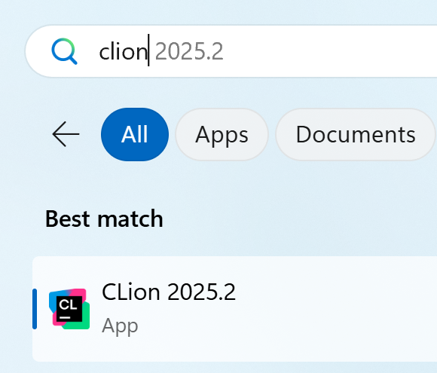
Search for CLion to open (Windows)

Slide 6
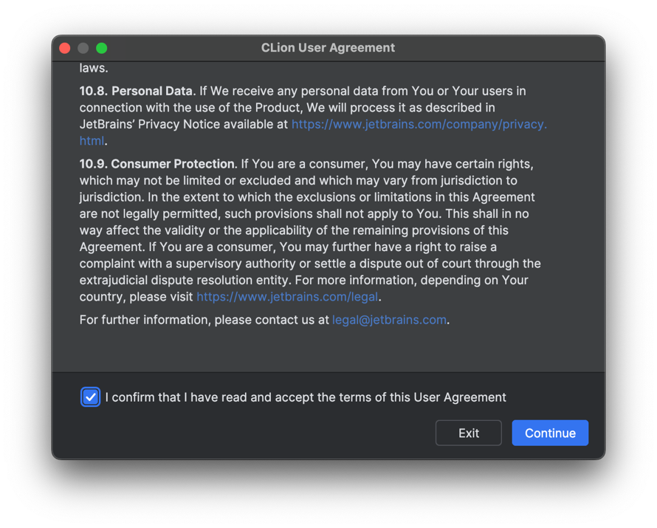
Read the User Agreement

Slide 7
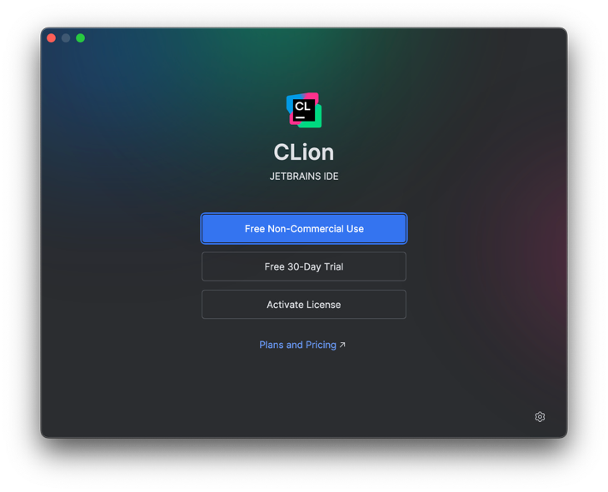
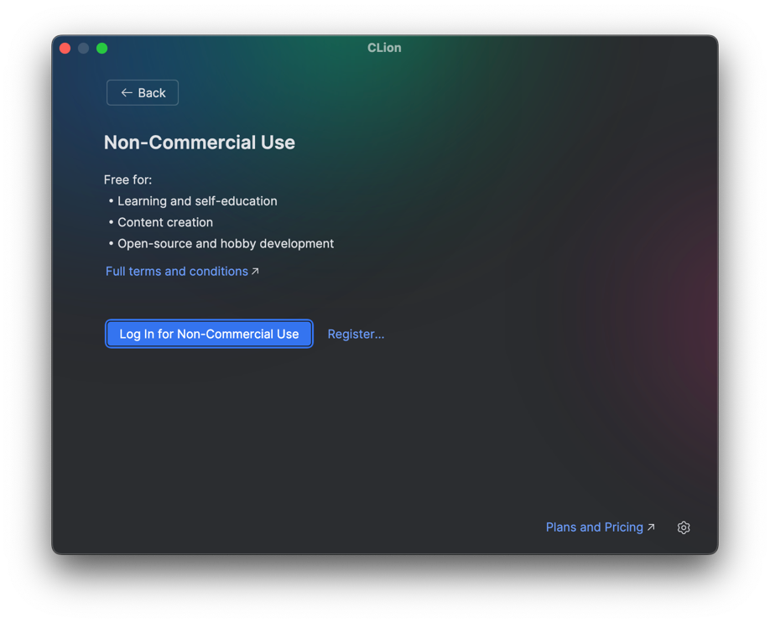
Choose for Non-Commercial Use

Slide 8
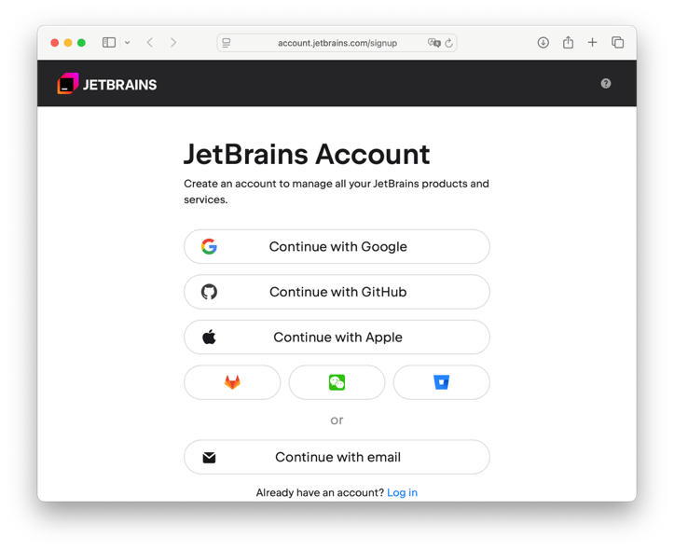
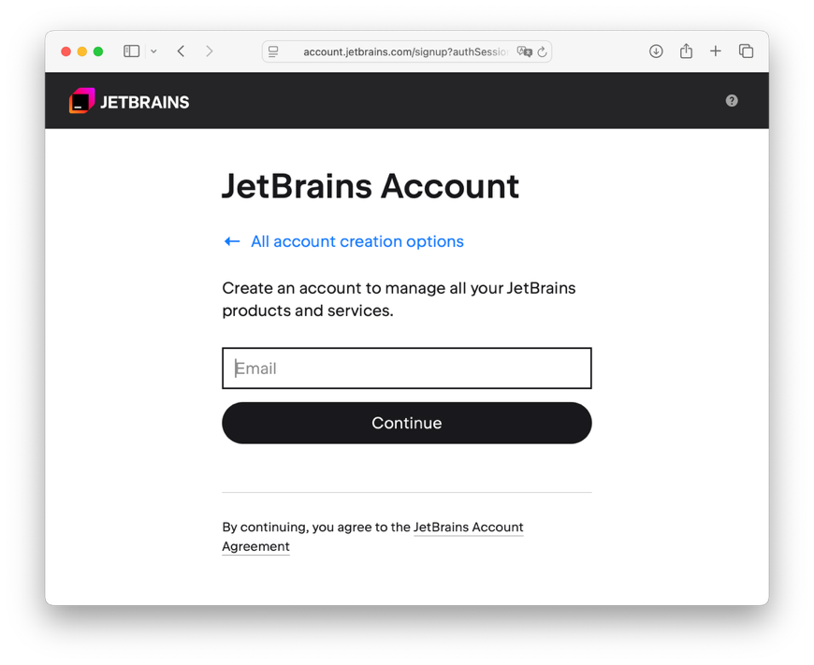
Set up an account with your
CUHK email
1155xxxxxx@link.cuhk.edu.hk

Slide 9
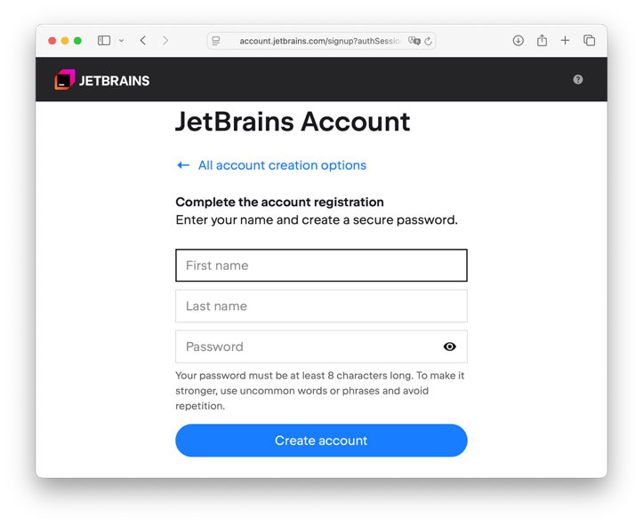
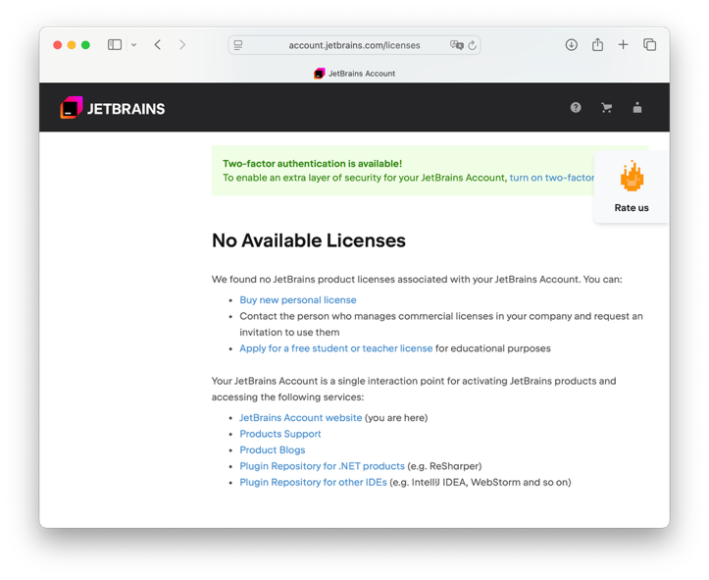
Register with your information
Success!

Slide 10
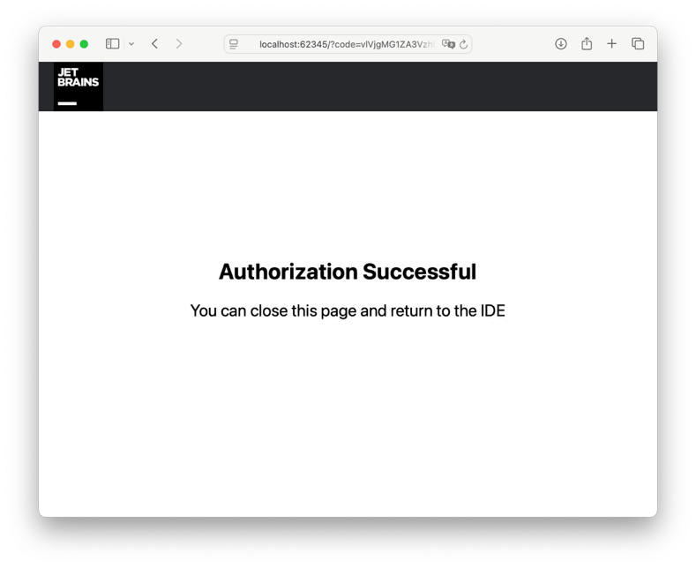
Return to CLion and log in with your new account

Slide 11
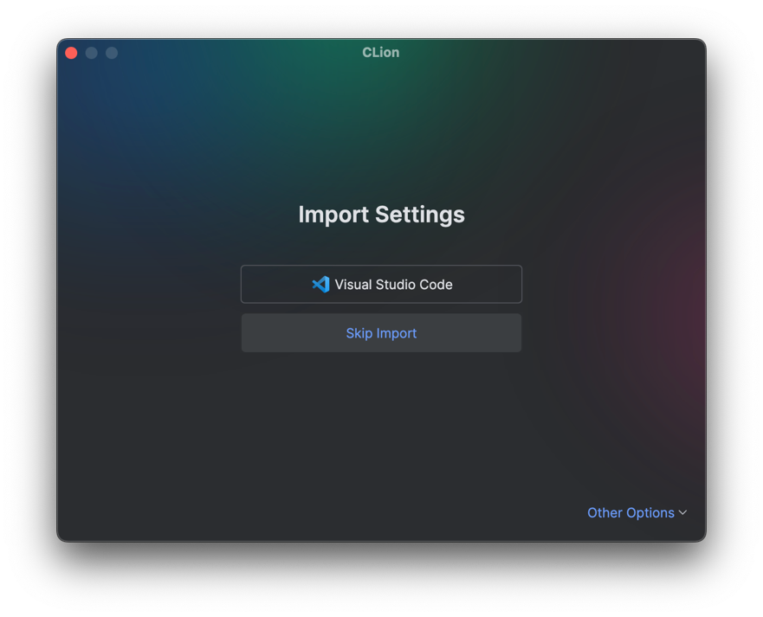
No need to import settings

Slide 12
Your free CLion license
You may read the agreement for this free license
  https://www.jetbrains.com/legal/docs/toolbox/license_non-commercial/
You must not use this for commercial development
The license is available for one year free of charge
You may wish to try the JetBrains student pack
  https://www.jetbrains.com/academy/student-pack/
  More assistance and AI tools
  (Note: You are not encouraged to use AI to help coding)

Slide 13
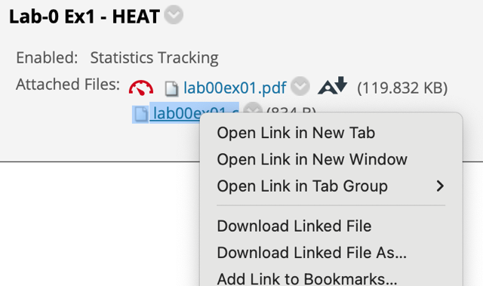
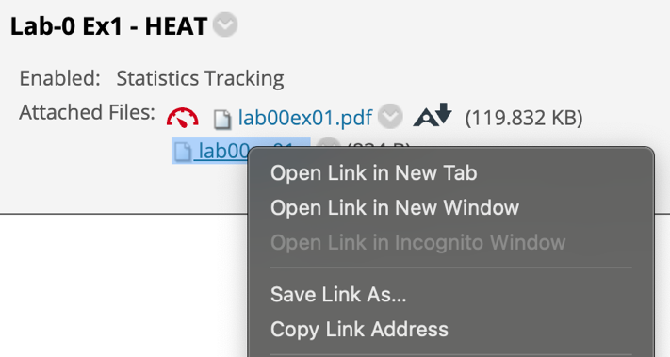
To start working on lab exercises
First, download the lab exercise starting code (skeleton file) from Blackboard
(Chrome)
(Safari)
Remember to choose this one “as…”
so that you can decide the filename

Slide 14
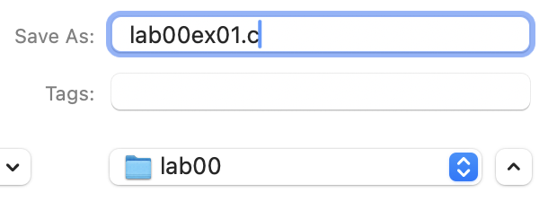
To start working on lab exercises
For example, set up an ENGG1110 folder, and lab folders inside. Make sure you save the file with the exact filename: lab??ex??.c
A wrong filename will be rejected by Gradescope

Slide 15
Open the file in CLion
Right click on the .c file and choose Open With » CLion, or
Drag the .c file towards the CLion icon in your task bar, or
Choose File » Open… and find your .c file
You may need to allow your OS to access your folders, or trust the destination folders
It’s okay whether you OK or Cancel the following configurations

Slide 16
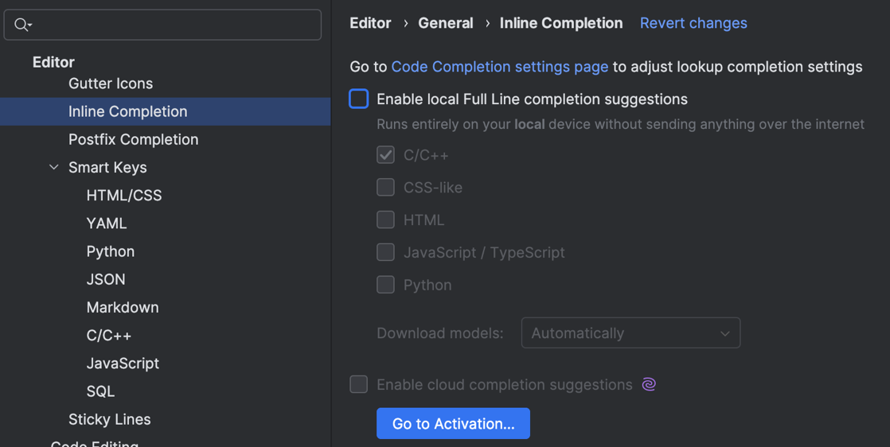
Disabling AI help
For learning's sake, you should disable the AI-assisted code auto-completion!
  Work hard and you CAN finish the tasks without such help
Settings »
Editor » Inline Completion
You also don’t need this

Slide 17
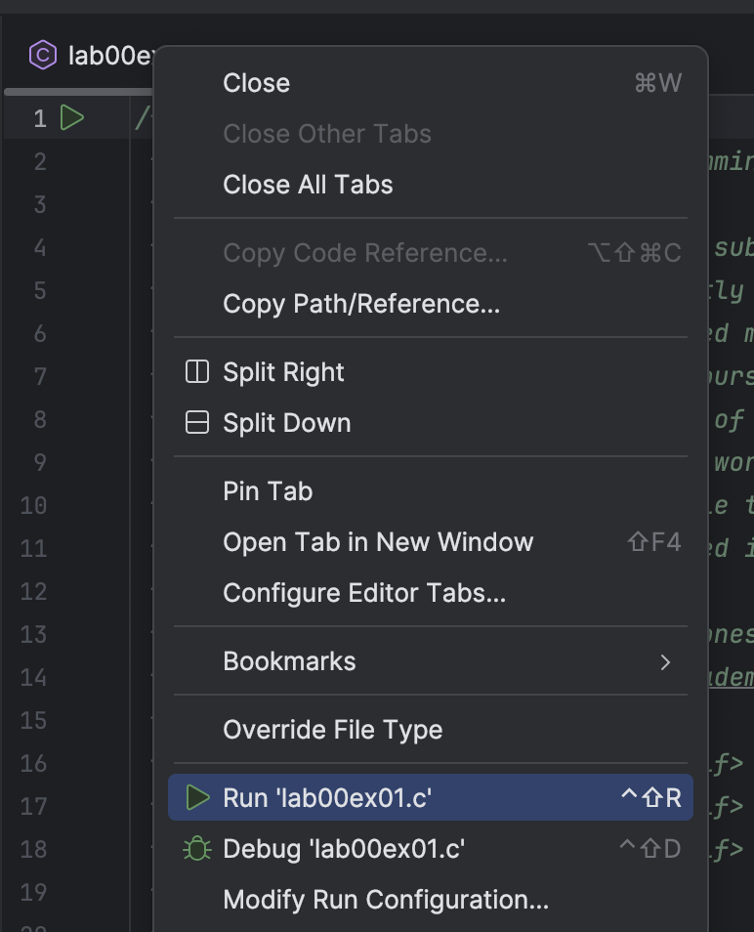
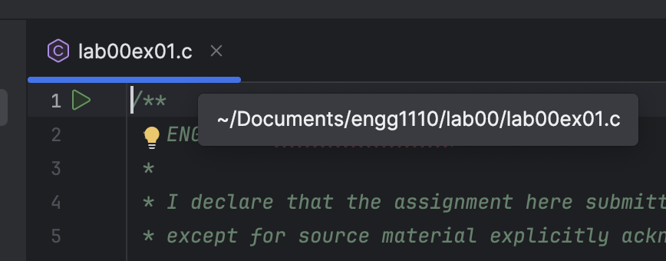
Right click and Run the code
Right click on the file tab

Slide 18
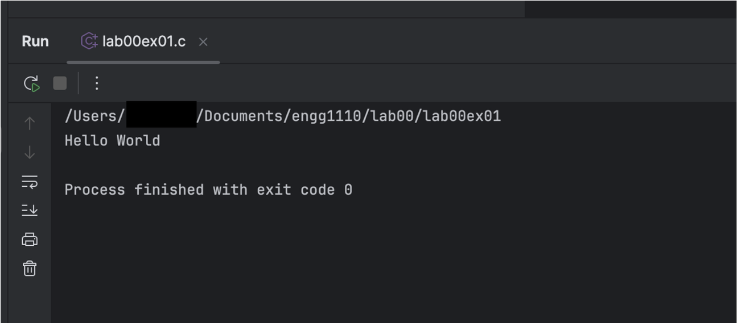
The results appear!
(…if the code works well)

Slide 19
Final words
If you check your files, next to the .c file, an executable file would be generated after running the code
There are much more functions in CLion to manage multiple source code files, external libraries, etc. as a project, but we will not cover it for now
Have fun coding!
If you are already a fan of other IDE, and C is supported, feel free to explore and try around

